Slide 1
Welcome to Hamble Class
2024 – 2025
Notes:
NOTE: To change images on this slide, select a picture and delete it. Then click the Insert Picture icon
in the placeholder to insert your own image.

Slide 2
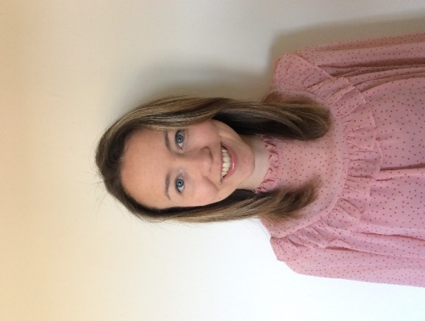
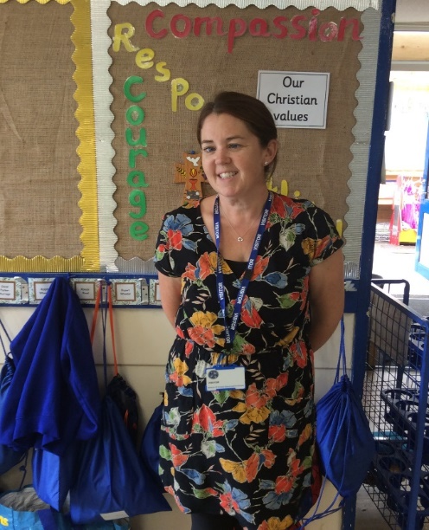
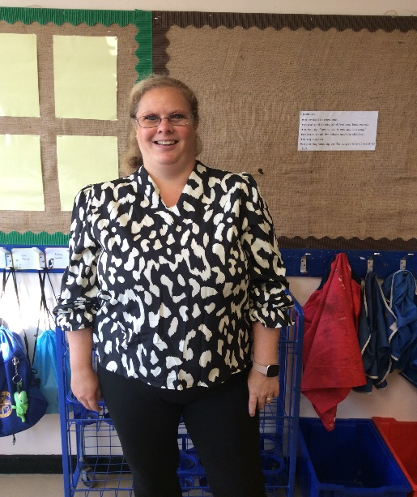
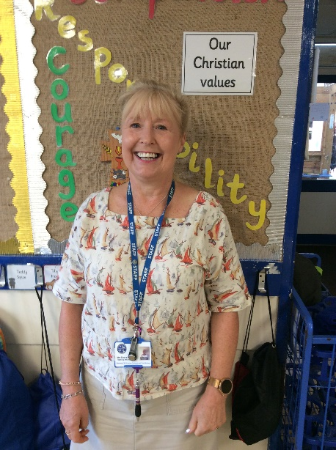
The Hamble Class Team
Mrs Tingley
Class Teacher
Mrs Holmes
Class Teacher
Mrs Bryder
Teaching Assistant
Mrs Brooking
Teaching Assistant
Notes:
NOTE: To change images on this slide, select a picture and delete it. Then click the Insert Picture icon
in the placeholder to insert your own image.

Slide 3
What does my child need?
Water bottle - named
Book bag – reading record / home contact book
Lunchbox – if applicable
A healthy snack if desired – fruit is provided by the school for break times
PE kit – including trainers, white t-shirt, navy shorts/tracksuit trousers in colder weather, spare socks. These are sent home each half term to be washed.
Notes:
NOTE: To change images on this slide, select a picture and delete it. Then click the Insert Picture icon
in the placeholder to insert your own image.

Slide 4
Our Topics
Autumn
Me, my home and my family
Spring
Up the beanstalk (Traditional tales)
Summer
The great outdoors!
Notes:
NOTE: To change images on this slide, select a picture and delete it. Then click the Insert Picture icon
in the placeholder to insert your own image.

Slide 5
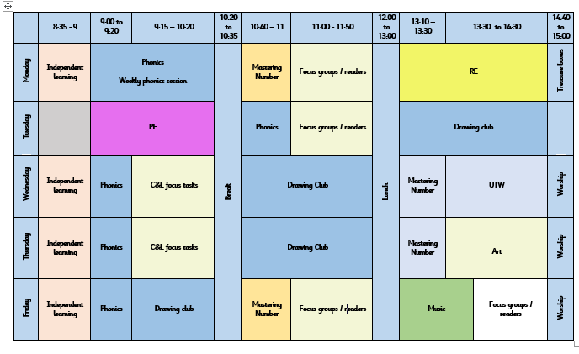
Our Timetable
The Purely Sport team teach Hamble PE on a Tuesday morning and Mrs Barter teaches Music on Friday mornings
An example of our timetable
We run continuous provision throughout the day, where the children access different areas of the classroom, completing adult directed and their own self - initiated tasks
Notes:
NOTE: To change images on this slide, select a picture and delete it. Then click the Insert Picture icon
in the placeholder to insert your own image.

Slide 6
Assessment
School Assessments
Song of Sounds assessments
Formative Assessments
Statutory Assessments
Reception: Baseline Assessment
Reception: EYFS Profile – June 2025
Notes:
NOTE: To change images on this slide, select a picture and delete it. Then click the Insert Picture icon
in the placeholder to insert your own image.

Slide 7
Forest School Hamble class will attend forest school sessions in the Spring term. The children will need – waterproof all in one OR waterproof coat and trousers Long sleeved top and long trousers. Thick socks Hat, scarf and gloves Wellies or waterproof boots. The forest school setting is on site. We treat it like an outdoor classroom. The children complete different craft activities using nature and also get to use the fire for a cooking activity. They will learn how to use different tools.
Notes:
NOTE: To change images on this slide, select a picture and delete it. Then click the Insert Picture icon
in the placeholder to insert your own image.

Slide 8
Show and tell
Show and tell will be held on a Monday and Friday afternoon.
We would like to encourage WOW moments – learning a new skill, a swimming award, sharing exciting news etc
Please rehearse with your child to help prepare them for their show and tell. Uploading photos onto Tapestry is a useful way to share photos and help children share their wow moments with the class.
Birthdays
Children are allowed to wear their own clothes on their birthdays. If they have a birthday during a school holiday or on a weekend, they can choose the next nearest school day to wear their own clothes to school.

Slide 9
Phonics Workshop
A phonics presentation will be delivered by the Hamble team on
Wednesday 2nd October at 08:45am.
Families will then be invited into Hamble Class later
in the term to take part in a phonics session with
their child. A letter will go out next week (week 3) with
more information and dates for these sessions.
Notes:
NOTE: To change images on this slide, select a picture and delete it. Then click the Insert Picture icon
in the placeholder to insert your own image.

Slide 10
Home Learning
Home learning for Reception will start after October half term. Communication and language will be our focus. This will be set on Tapestry.
Notes:
NOTE: To change images on this slide, select a picture and delete it. Then click the Insert Picture icon
in the placeholder to insert your own image.

Slide 11
Home Learning – Reading
Reading with and to your child helps them to access all areas of the curriculum – this can’t be done too much!
Promoting a love for reading is key
There is more to reading than just ‘reading’ – exploring the cover, blurb, making predictions, looking at vocabulary…
Big Cat Collins Reading Books – suggestions at the back of the book
Books will be changed on a Monday & Friday
Notes:
NOTE: To change images on this slide, select a picture and delete it. Then click the Insert Picture icon
in the placeholder to insert your own image.

Slide 12
I did nothing today! – Author Unknown
When children come home At the end of the day, There’s a question they’re asked As they scurry to play.
“Tell me, what did you do in school today?” “Nothing. I did nothing today!”
Perhaps nothing means that I played with blocks. Tied my own shoes, or found beautiful rocks. Maybe the monarchs hatched today. Or maybe I found a new friend to play.
Maybe today was the very first time My scissors followed a very straight line. Perhaps I learned a new song, and sang all the words, Or I touched a feather from the strangest of birds.
When you’re in school and your heart has wings, “Nothing” can mean some wonderful things!
Notes:
NOTE: To change images on this slide, select a picture and delete it. Then click the Insert Picture icon
in the placeholder to insert your own image.

Slide 13
Thank you for coming! Do you have any questions?

